Slide 1














Terp Foodie
Find the best restaurant for different tastes
0506 Team 8：
Rajesh Reddy Bogolu
Jingxian Tang
Yunfei Xia
Shenger Zhang
Urshilah Senthilnathan
Dec 8th 2021

Slide 2












CONTENTS
01
Background & Introduction
02
Database Design
03
Use Cases
04
Application & Conclusion

Slide 3






01
Background & Introduction

Slide 4

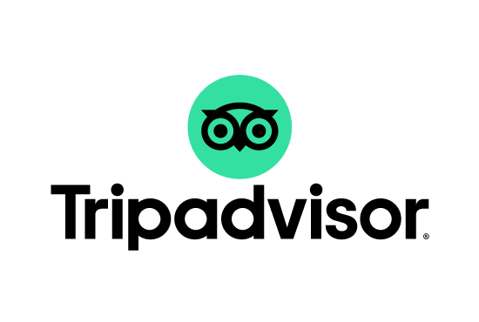
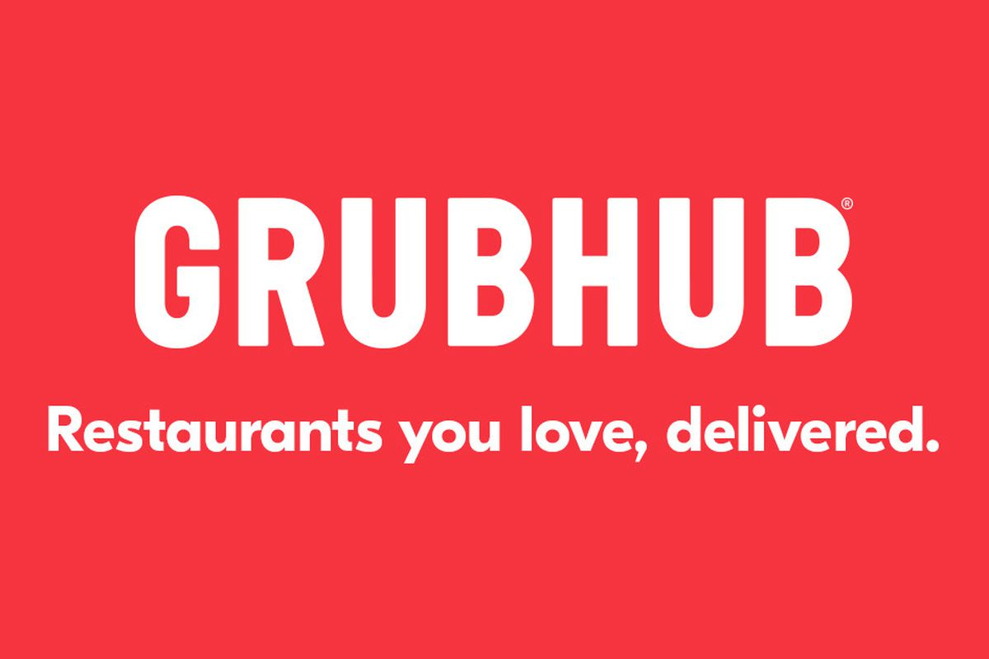
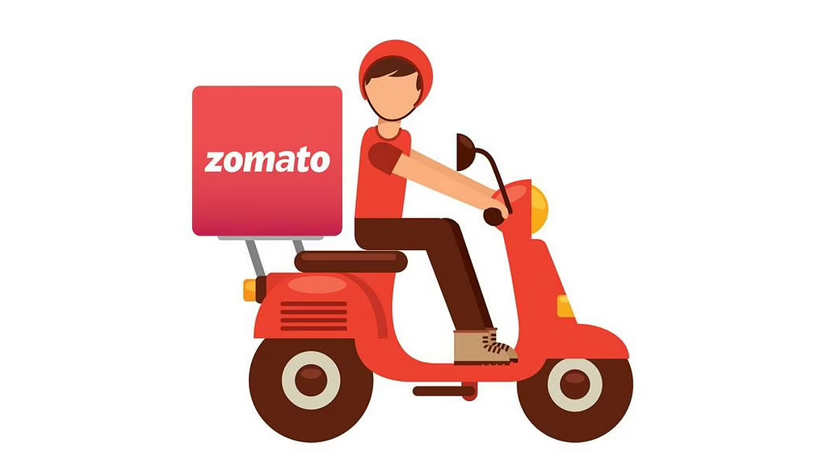

Who our users Are?
Our project aims to helping foodie in College Park to find the highest rated restaurants from different categories, and recommend a top dish for each top restaurant in its field.
What sources it includes?
We use data from 5 most famous review platform: Google Review, Yelp, TripAdvisor, Grubhub and Zomato.

Slide 5

1.Project Processes
We built a database for the restaurants in College Park to track each restaurant to analyze what kind of restaurants attract more customers’ reviews and higher ratings.

Slide 6
2.Mission Statement
To connect people with great local restaurants along the way, Terp foodie hopes to enrich the lives of consumers and small business owners. In pursuit of this mission, we aspire to provide the most helpful information possible about local restaurants.
To analyze the customers’ reviews to help local restaurants elevate service quality, Terp foodie hopes to build insight on the food preference from the customers’ reviews and ratings.

Slide 7
3.Mission Objectives：
To find the top 5 categories of local restaurants that get the highest rating.
To find the top 5 categories of local restaurants that get the most customer reviews.
To find the taste differences from each platform
To find the restaurant that gets the highest ratings
To find the restaurant that gets the most customer reviews
To find the recommendation for each popular category.

Slide 8
02
Database Design

Slide 9
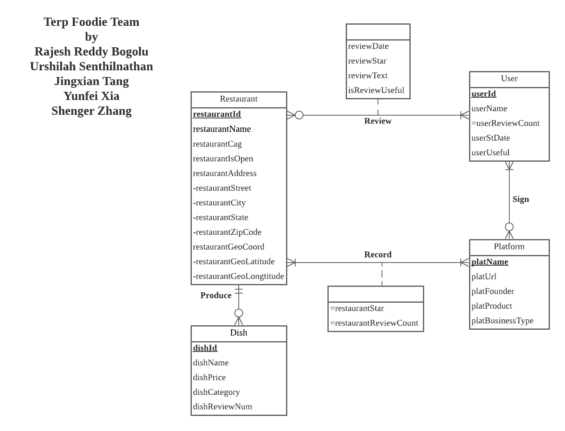
Logical Database Design——ER Diagram
Notes:
We have 4 entities in total: restaurant, user, dish and platform. When the users review the restaurant, we can get the review date. And the platform record the restaurant stars and review count for each restaurant. User

Slide 10
Logical Database Design——relational schema
Restaurant (restaurantId, restaurantName, restaurantCag, isOpen, restaurantStreet, restaurantCity, restaurantState, restaurantZipcode, geoLatitude ,geoLongitude)
dishes (dishId, restaurantId, dishName, dishPrice, dishCategory, dishReviewNum)
User (userId, userName, userStDate, userUseful)
Review(userId, restaurantId, reviewDate,reviewStar, reviewText, isReviewUseful)
Platform (platName,platURL,platFounder,platProduct,platBusinessType)
Record (restaurantId, platName, restaurantStar, restaurantReviewCount)
Sign (platName,userId)
Notes:
Each restaurant has a unique identifier and is required to restore restaurant name, address, stars, review count, and restaurant categories.
Each user has a unique identifier and is required to restore the user name and user review count.
Each platform has a unique plat name and restore the plat link, platFounder, platProduct, and plat Business Type.
Each Dish has a unique identifier and is required to restore the dish description, dish price, dish category, and dish review number.

Slide 11
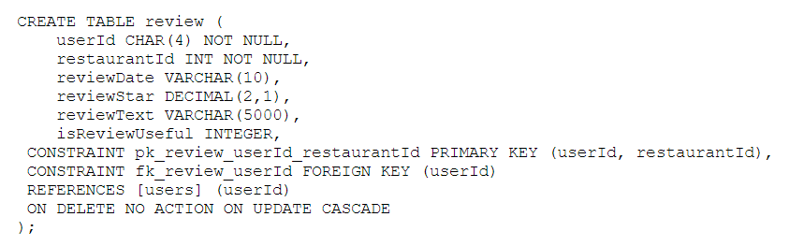
Physical Database Design

Slide 12
03
Application

Slide 13
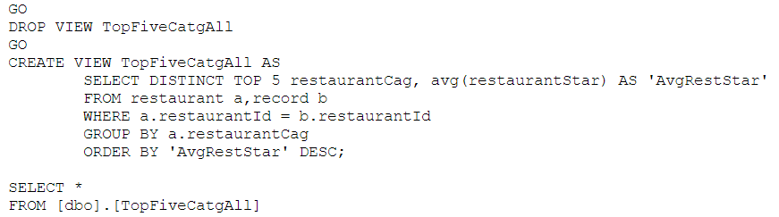
1.What are the top 5 categories of local restaurants from all the platform that get the highest rating?

Slide 14
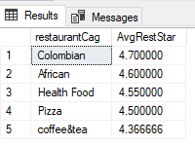
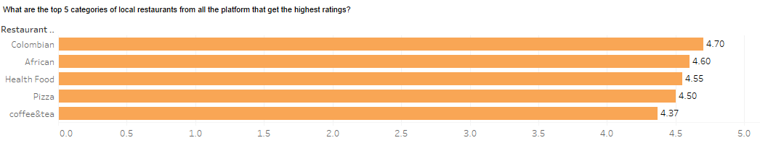
Output

Slide 15
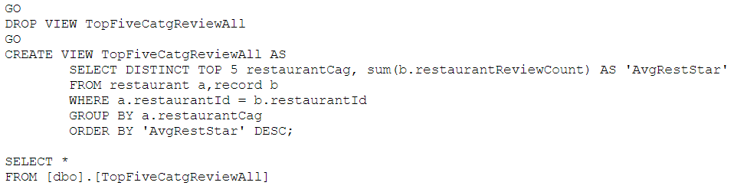
2.What are the top 5 categories of local restaurants from all the platform that get the most reviews?

Slide 16
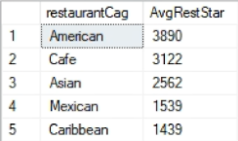
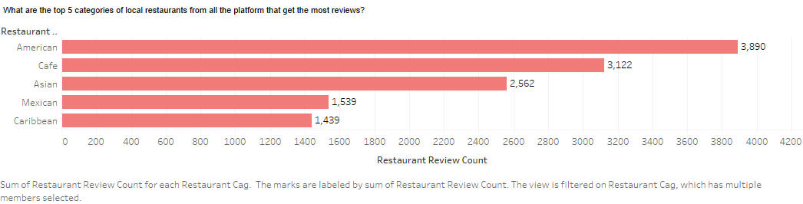
Output

Slide 17
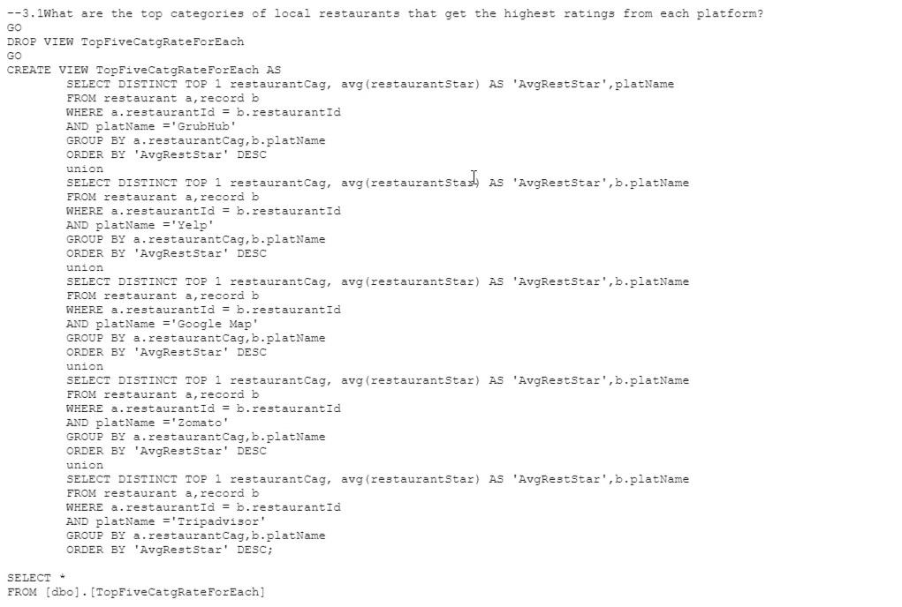
3.1What are the top categories of local restaurants that get the highest ratings from each platform?

Slide 18
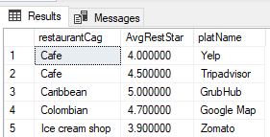
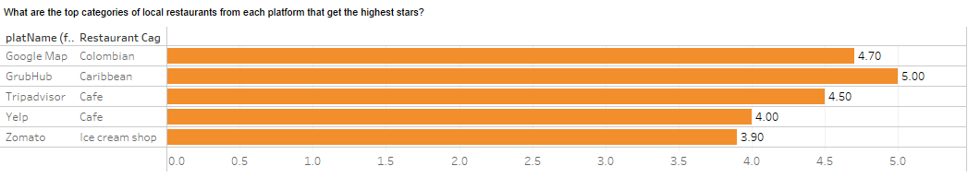
Output

Slide 19
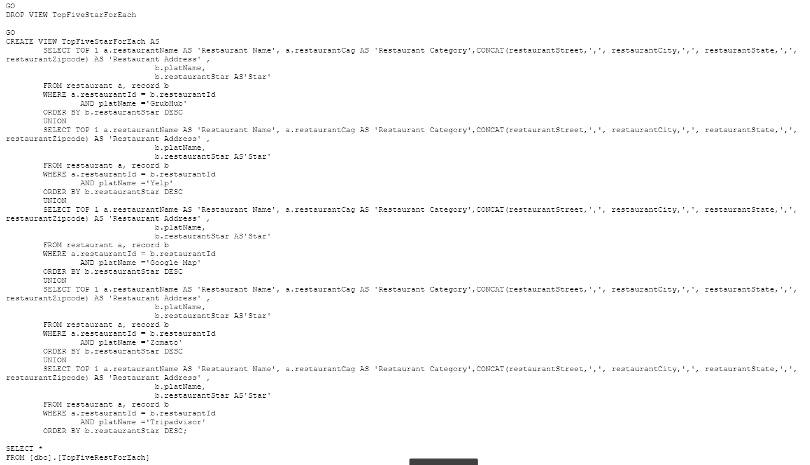
3.2 What are the top restaurants names and addresses and categories that get the highest ratings in each platform?

Slide 20
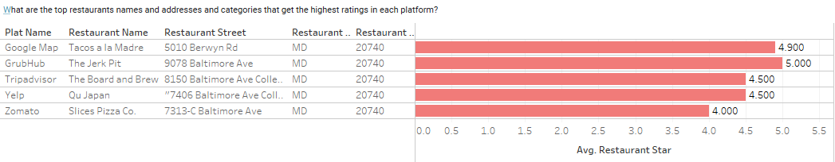
Output

Slide 21
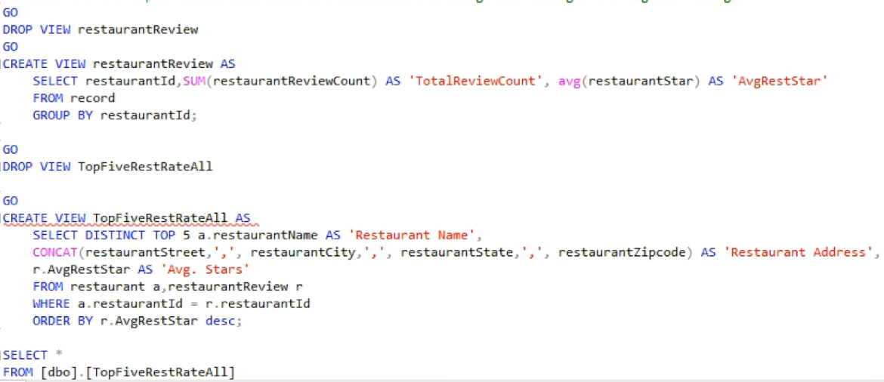
4.What are the top 5 restaurants’ names and addresses and categories that get the highest ratings?

Slide 22
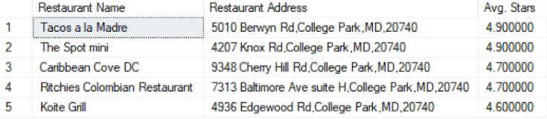
Output

Slide 23
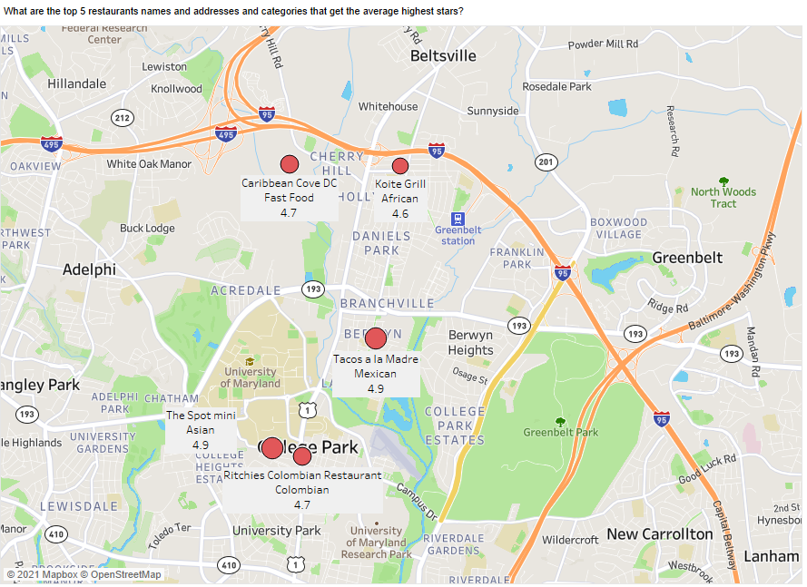

Slide 24
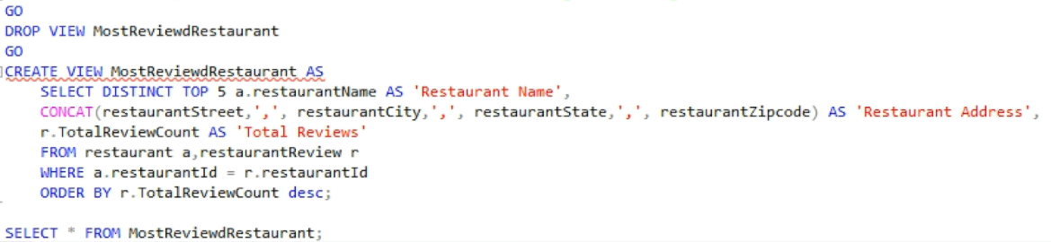
5. What are the top 5 restaurants names and addresses and categories that get the most reviews?

Slide 25
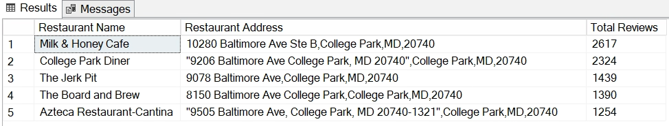
Output

Slide 26
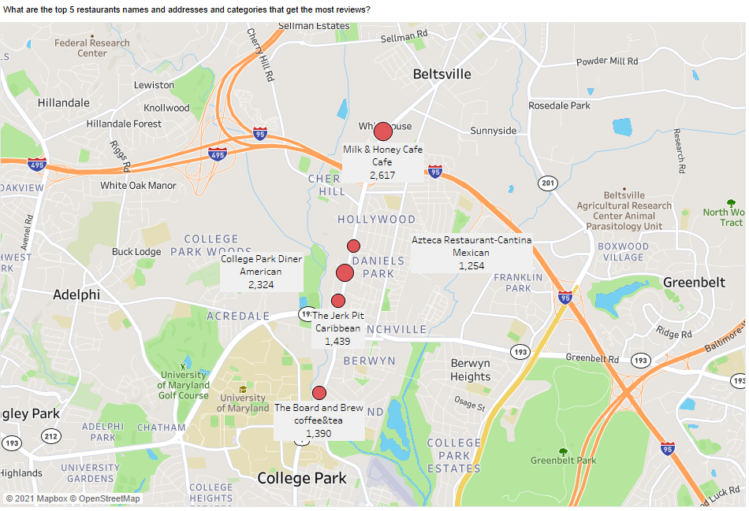

Slide 27
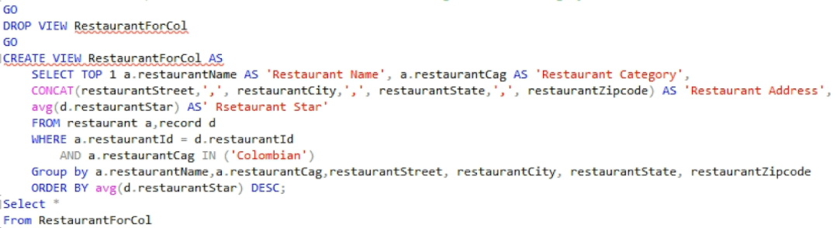
6.1. What are the top restaurant names and addresses of the highest-rated category?

Slide 28
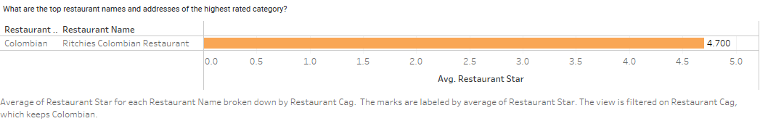
Output

Slide 29
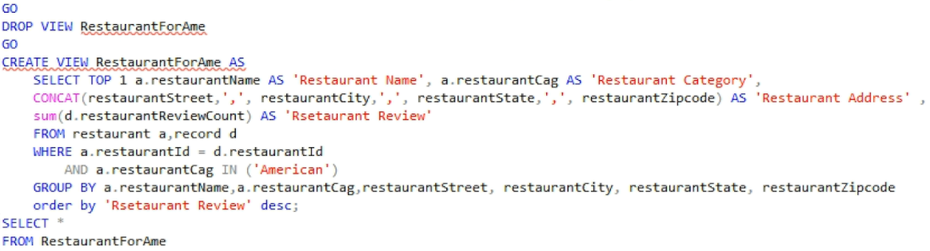
6.2. What are the top restaurant names and addresses of the most popular category?

Slide 30
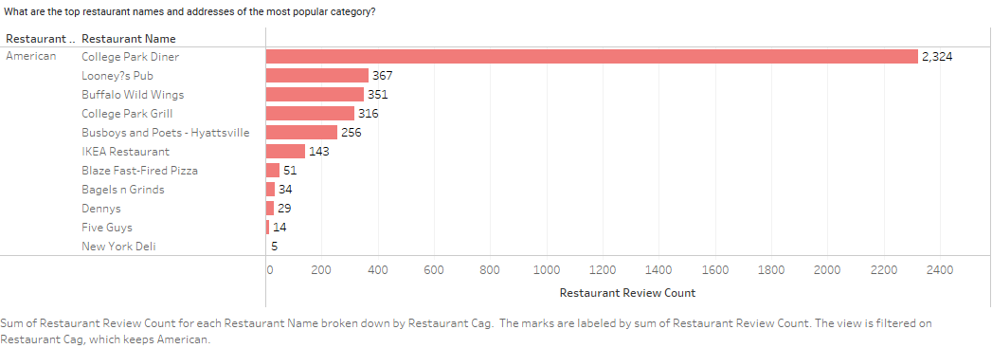
Output

Slide 31
04
Conclusion

Slide 32
Conclusions:
The most popular restaurant category in College Park is American food.
The restaurant category that has the best quality in College Park is Columbian food.
The most popular restaurant in College Park is Milk & Honey Cafe.
The restaurant that you must go in College Park are The Spot Mini and Tacos a la Madre.

Slide 33
Future Works:
Find the most recommend dishes for top rated restaurants.
Find the relationship between user reviews and restaurant rates.
Analyze the content of reviews and provide suggestions for local restaurants to improve their services.

Slide 34
THANKS

